Slide 1
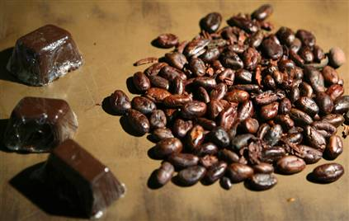
“CHOCOFAIR”

Slide 2
Framework
main.html
    d3, topojson
style.css
map_script.js
script.js
data.py
cocoa_import.csv
cocoa_export.csv
chocolate_import.csv
chocolate_export.csv

Slide 3
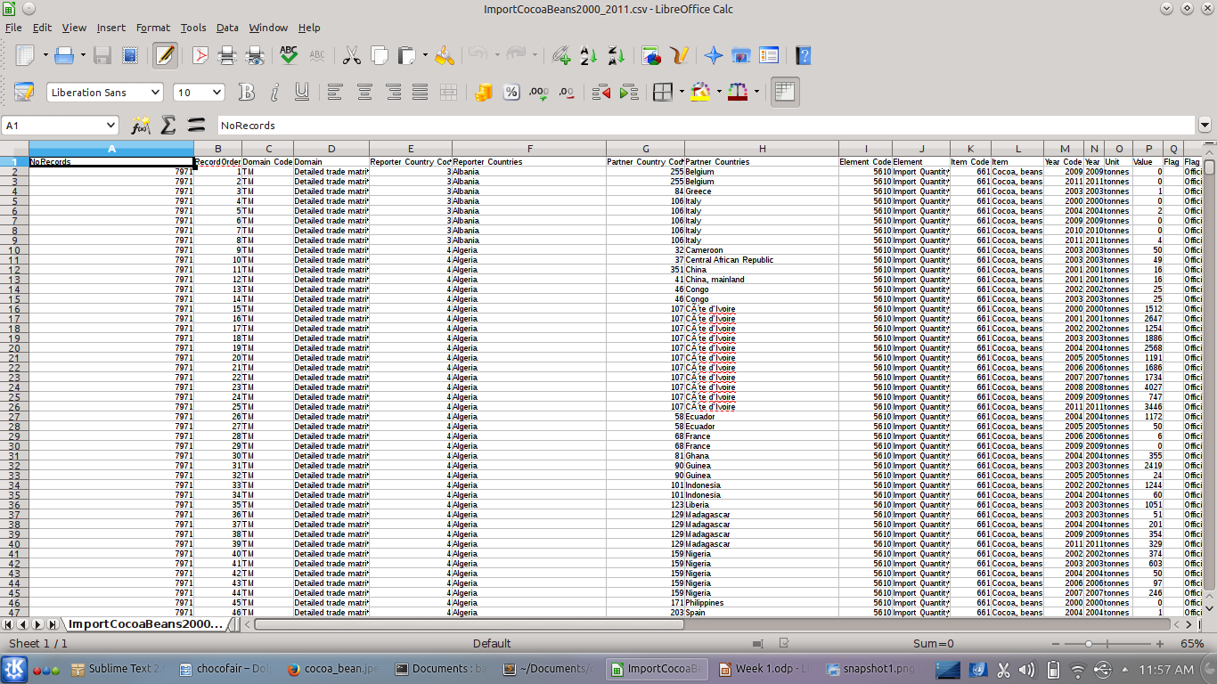
Data

Slide 4
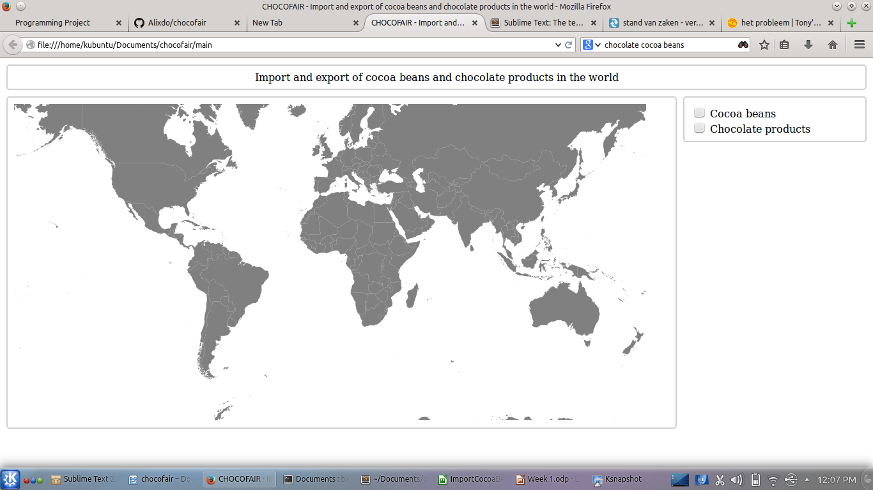
Visualisation
file:///home/kubuntu/Documents/chocofair/main
file:///home/kubuntu/Documents/chocofair/main

Slide 5
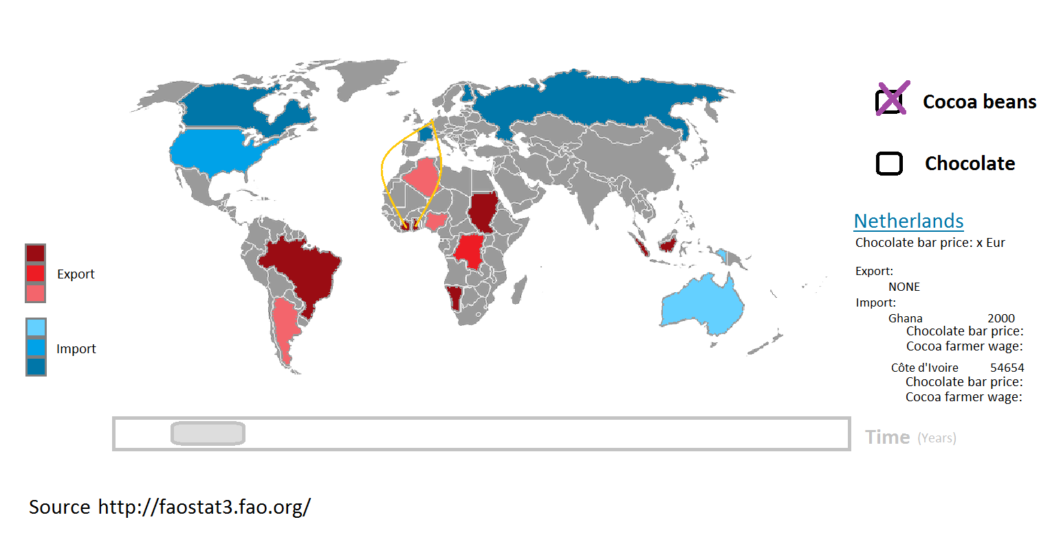
Visualisation

Slide 6
Questions ?

